Slide 1
Credit card Analysis and Prediction using ML model
Abstract:- This Project is for the doing the basic exploration and analysis for the credit card data set and predict the customer how is eligible for the credit card using various ML model and finding the best model for the prediction.
From :-Lokesh R
BE Graduate (AE)
Aspiring Data scientist

Slide 2
The Credit card companies makes profits from the 3 major area which are interest ,annual fees charges and transaction fees.
So number of the credit card holder increases, the profit of the company also increase so it is very important to predict the custom who gone use the credit card which will help the companies growth and predicting accurately will help companies overall profits.
The dataset which was taken for the analysis is from Kaggle:- “kaggle kernels output umerkk12/credit-card-predictive-analysis -p /path/to/dest”
The Data set consist of missing values which was imputed using the suitable techniques.
The Data set consist of outliers which was even deal with the suitable techniques.
The Dataset was an supervised classification model which means the output variable was given and the outcome variable was categorical.
For the exploration of the data was done by using the python libraries like Numpy (For numerical operation),Pandas(For Dealing with the Data Set), Matplotlib(For plotting graph), seaborn(Data visualization ), plotly(For data visualization),and sklearn (For Feature Engineering and Machine learning ).

Slide 3
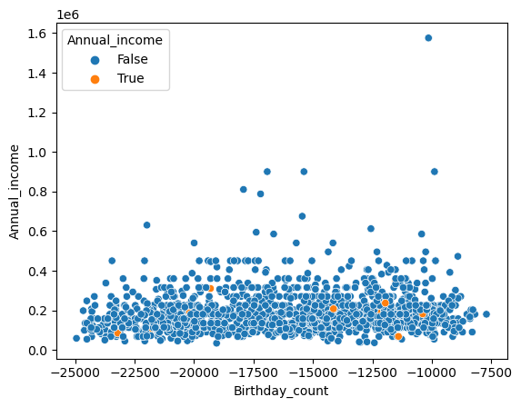
The first part of the project was to deal with missing values so to out missing values and any wrong entry pandas library was use and to impute the missing value fancy imputer was use because data set imputed by this method was showing good accuracy compare to other method.
True - The imputed values.
False -The actual values.
From the image we can see that the imputed values are very much near to the other data point in the data set because of which the dataset gives good accuracy when compare to the other imputing method.

Slide 4
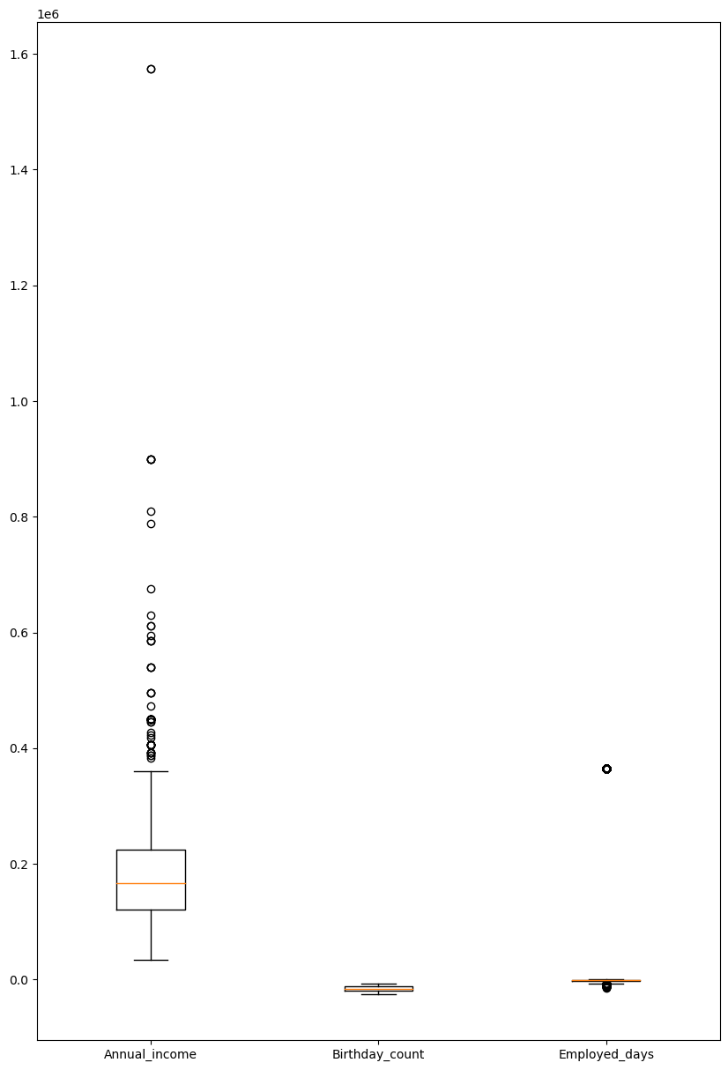
There were outliers present in the numerical data set so to deal with outliers IQR method was used because the dataset is skewed and for the IQR is best method find out .
From the plot we can se that the some columns has lot of outliers and some of them has les outliers which are to be deal .
To deal with outliers 3 type of approach was take which are dropping outliers ,replacing outliers and keeping outliers .

Slide 5
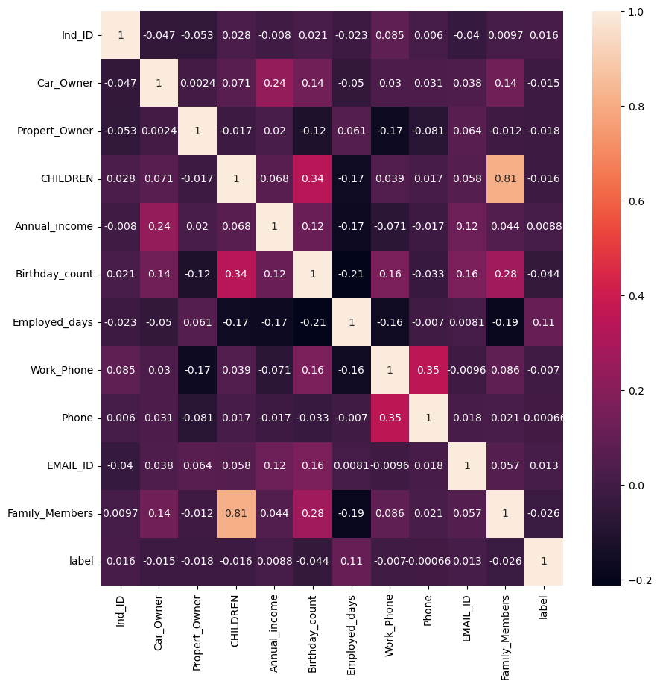
Correlation analysis :-
For the correlation analysis spread man correlation was used because for the label data is categorical we cant use other king of correlation.
From the plot we can see that family member and children has very strong relation other than that there is no strong relation between other variables.

Slide 6
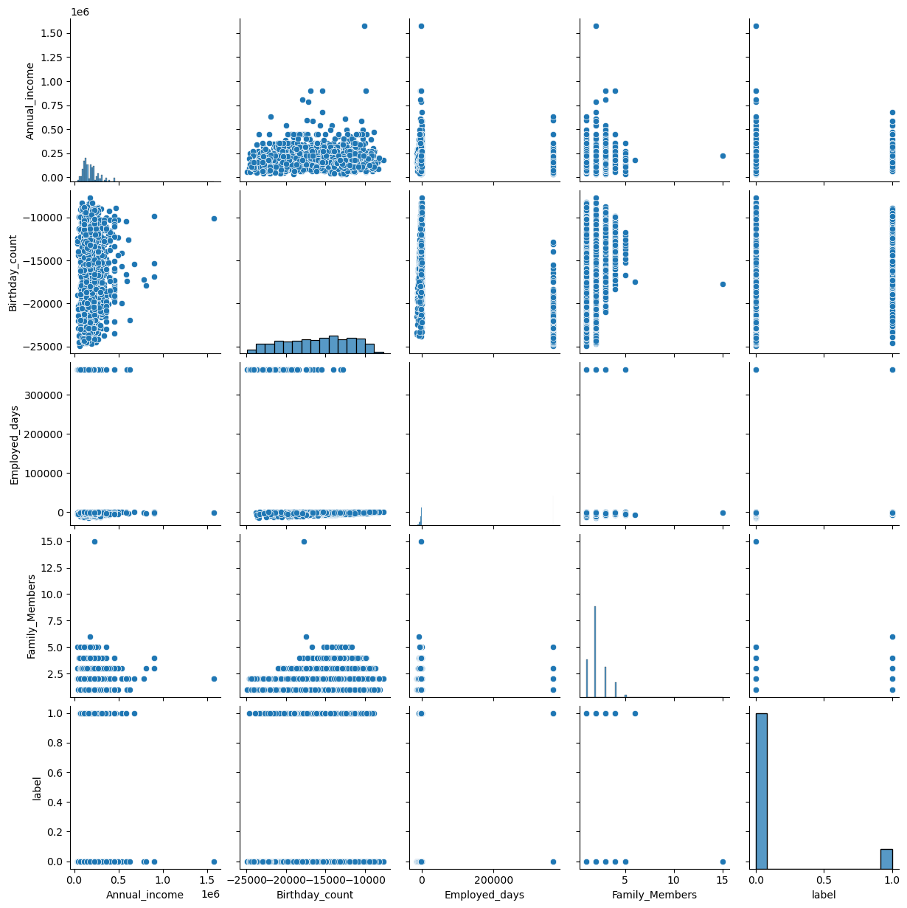
Hypostasis analysis:-
From the plot we can see that there is no proper relation between any kind of variable so we can’t use any logistic regression so we can use other kind of ML model like KNN,SVM etc.

Slide 7
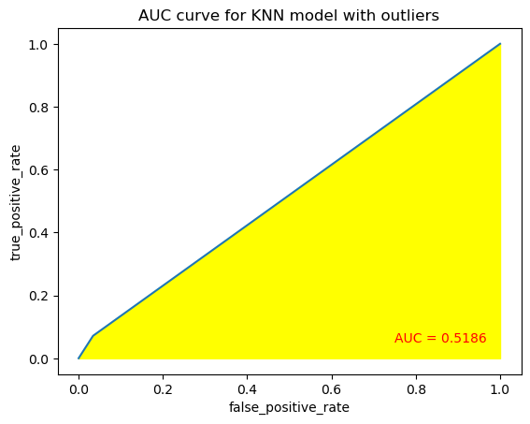
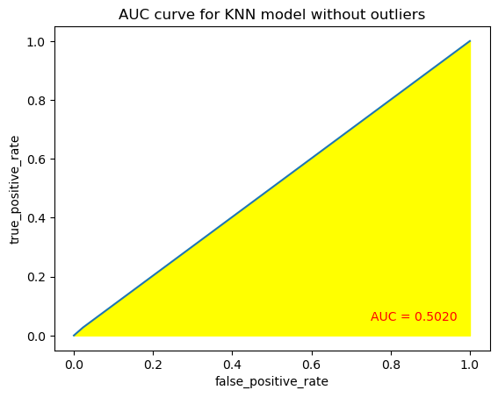
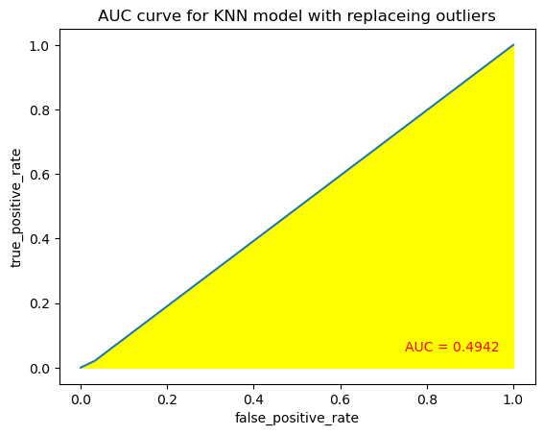
For the train the ML model we have to deal with outliers so it can be deal in 3 ways
The dataset was trained for 3 different way of dealing outliers and got the 3 different accuracy for the same ml parameter.
The accuracy of the model with outliers = 85.80645161290322%.
The accuracy of the model without outliers = 89.82456140350877%.
The accuracy of the model with replacing outliers = 86.56330749354005%.
Now we can see that data with outliers has the highest accuracy compare to other 2 ways.
So we can say that outliers may not effect the prediction of the model so for the further prediction with different ML model will outliers have outliers.
And from the plot we can see that AUC curve for the all the 3 different type of model does not have much changes the area under the plot is almost the same.

Slide 8
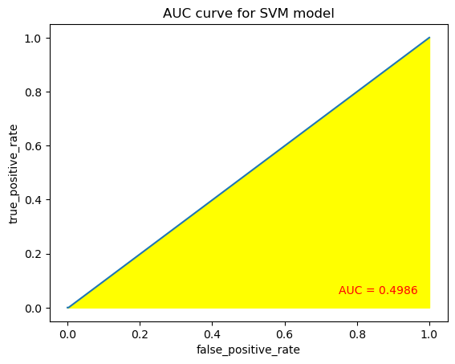
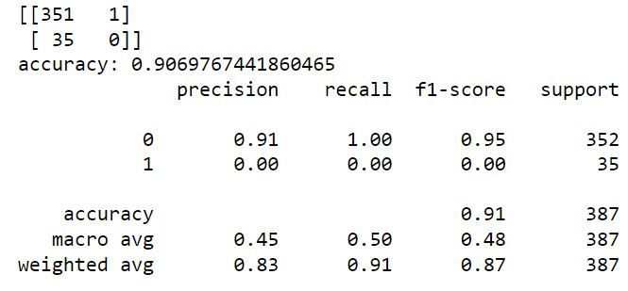
The dataset was then trained for the different type of classification model where to find the best output.
The model which were used for the prediction was
Support vector machine.
K Neighbors Classifier.
Decision Tree Classifier.
XGBoost.
Random Forest Classifier.
1)Support Vector machine model was trained with parameter with (C=1,gamma=1,kernel='linear‘).
Where c=Regularization Parameter ,gamma=Kernel Coefficient ,kernel =dividing plan

Slide 9
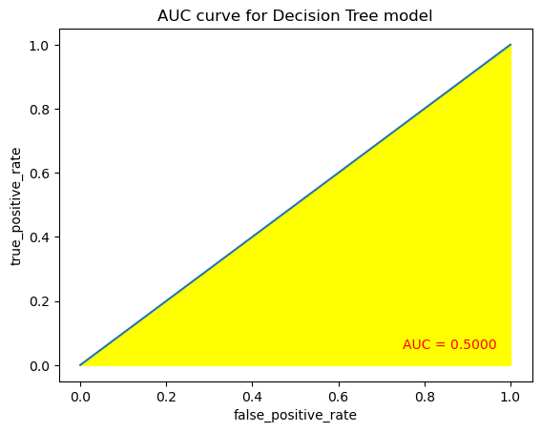
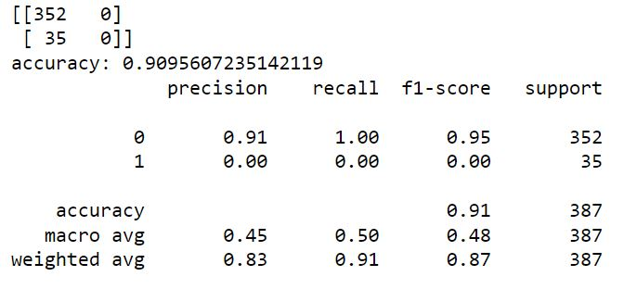
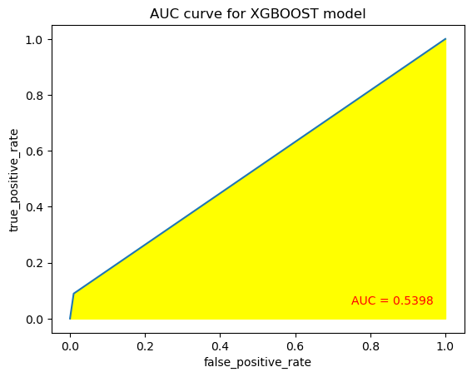
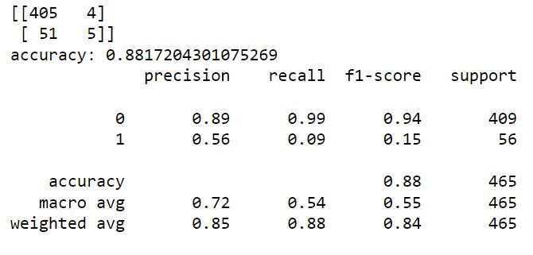
Decision Tree Classifier model was trained with parameter with (criterion='entropy',max_depth=3,splitter='random').
Where Criterion is method for selecting the variables from data ,max_depth =number of trees
XGBoost model was trained with parameter with (gamma=0.1,n_estimators=4).
Here Gamma is minimum error step and estimators is number of trees

Slide 10
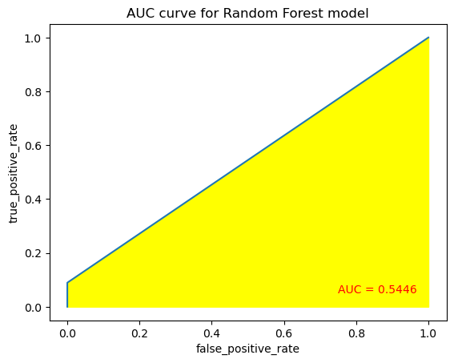
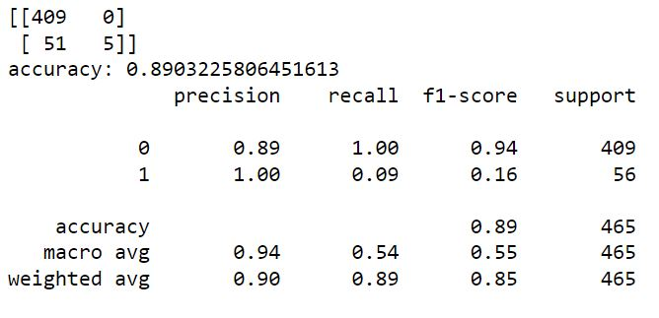
Random Forest Classifier model was trained with parameter with(criterion='gini',max_depth=9,max_features='log2',n_estimators=10).
Here criterion is the precition of the feture ,n_estimators=number of tree.
Conclusion :-
From the AUC curve for the area under the curve for Random forest model has the highest area with 89.03% of accuracy.
And the highest accuracy is for the decision tree with 90.95% and the AUC curve area is 0.50.
Therefore Random forest classifier and Decision tree are the best model with give parameter are the best fit for the prediction of the credit card.

